Slide 1
Rocky Reach Generator Cooling System Analysis
Dante Ramirez

Slide 2
Objectives
Explain the Hydro Generation data set
Predictors, Observations, NA’s, Imputations…
Describe Units
Offline hours and failures, Hours overheated…
Show Relationships
Average cooling air temperature ~ , Seasonality, Unit
Report Business Intelligence Decisions
PLC changes, Unit diagnostics, Dashboard showcase

Slide 3
Explain: Data
5 Rocky Reach 120,000 KVA unit capacity generators (pg 5, GenCoolingWaterSystems_RR)
Retrofit with new stators and rotors in 2002 by ABB (pg 4, RotarStator_RR)
5 predictor variables.
Average stator winding temperature (c)
Total generator electrical current (A)
Average cooling water flow (gal/min)
Average cooling water temperature (c)
Average cooling air output temperature (c)
8760 1-hour observations per unit.

Slide 4
Explain: Cleaning
Pivoted Longer
Unit to 5-level factor
Coerced 53 NA’s to 0
Unit C4 had most at 15, Unit NA range (8, 15)
Predictor NA range (9, 11)
Mutations
Unit Status, Season, Overheated, Clean column names
Future: Column for operating mode (Automatic / Manual) (pg 5, GenCoolingWaterSystems_RR)

Slide 5
Describe: Unit 6
Offline 480 hours (5.48% of total possible operating hours)
MONTH | HOURS | % HOURS
Jan | 29 | 3.9%
Feb | 0 | 0%
Mar | 56 | 7.5%
Apr | 0 | 0%
May | 0 | 0%
Jun | 3 | .4%
Jul | 1 | .1%
Aug | 9 | 1.2%
Sep | 141 | 19.6%
Oct | 166 | 22.3%
Nov | 16 | 2.2%
Dec | 59 | 7.9%

Slide 6
Describe: Running Time and Heat
Unit C5 had the most online hours with 8716
SAlso had the third highest overheated hours with 8683
“Overheat” defined in Generator Cooling Water manual.
UNIT | ONLINE HOURS | OVERHEAT HOURS | TOTAL HOURS | % OVERHEAT
C2 | 8441 | 7874 | 8760 | 89.89%
C4 | 8446 | 8544 | 8760 | 97.53%
C5 | 8716 | 8683 | 8760 | 99.12%
C6 | 8280 | 8749 | 8760 | 99.87%
C7 | 8563 | 8758 | 8760 | 99.97%
Same % OVERHEAT peripherals, different ONLINE HOURS outcomes
Indicates issue other than overheating stators?

Slide 7
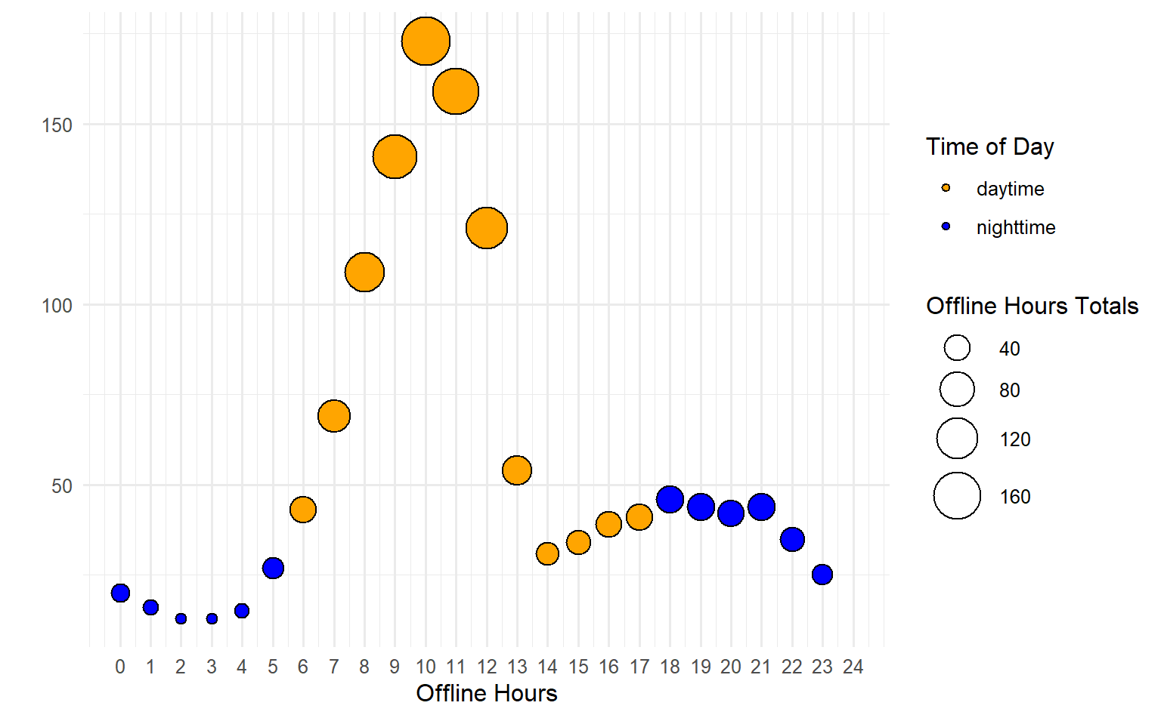
Describe: Offline Hours

Slide 8
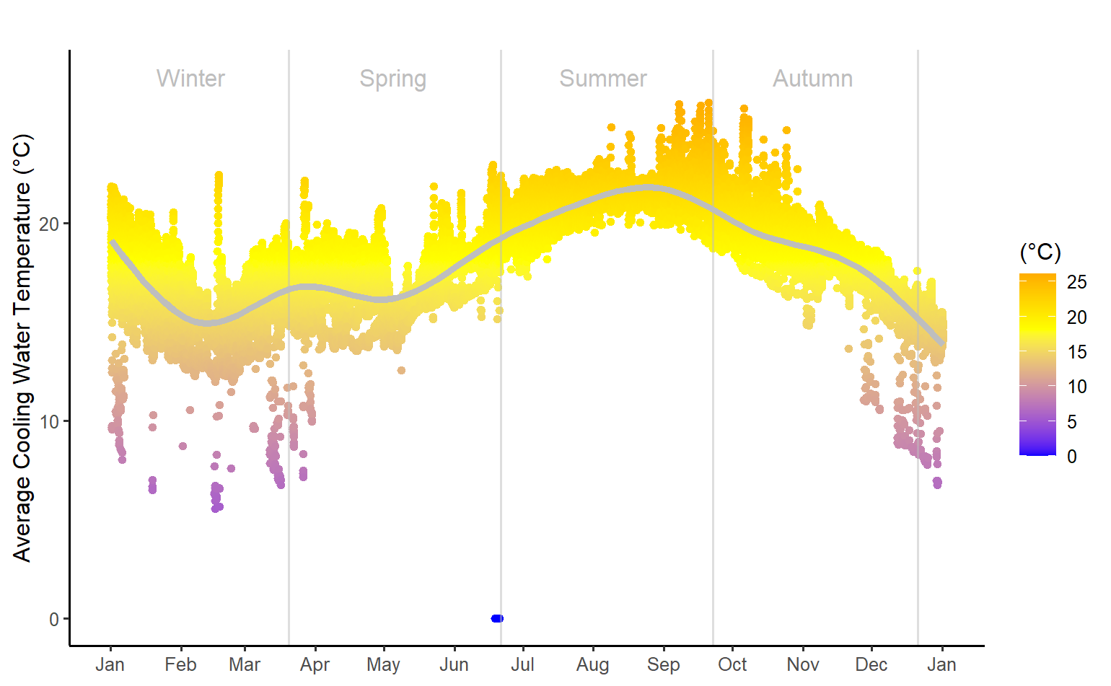
Show: Cooling Water Temperature

Slide 9
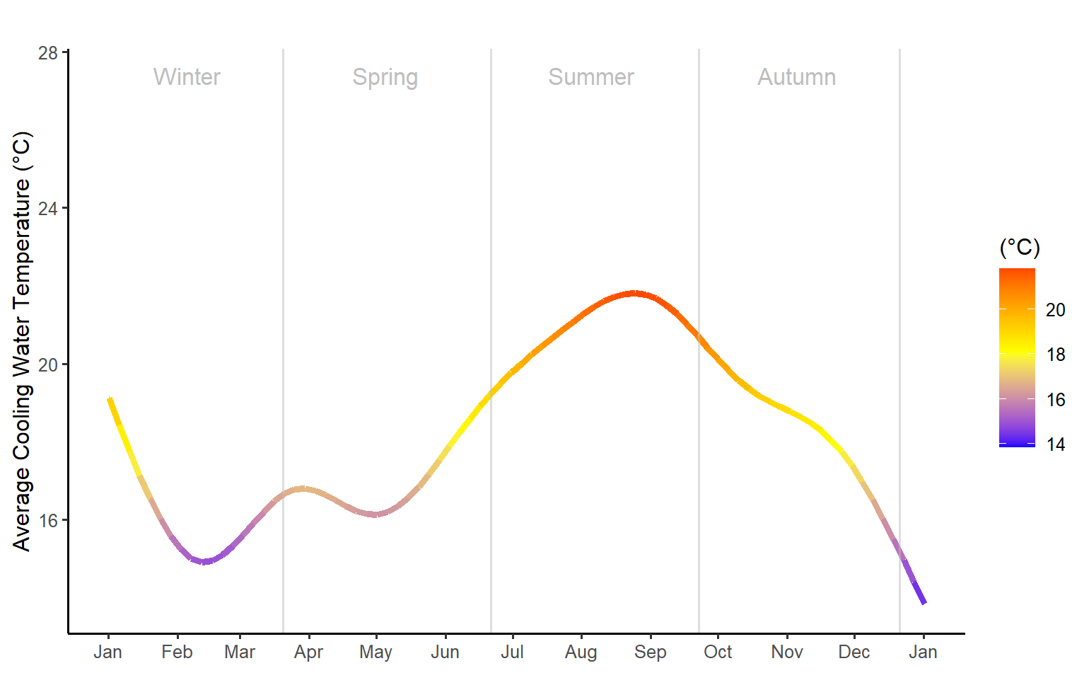
Show: Cooling Water Temperature

Slide 10
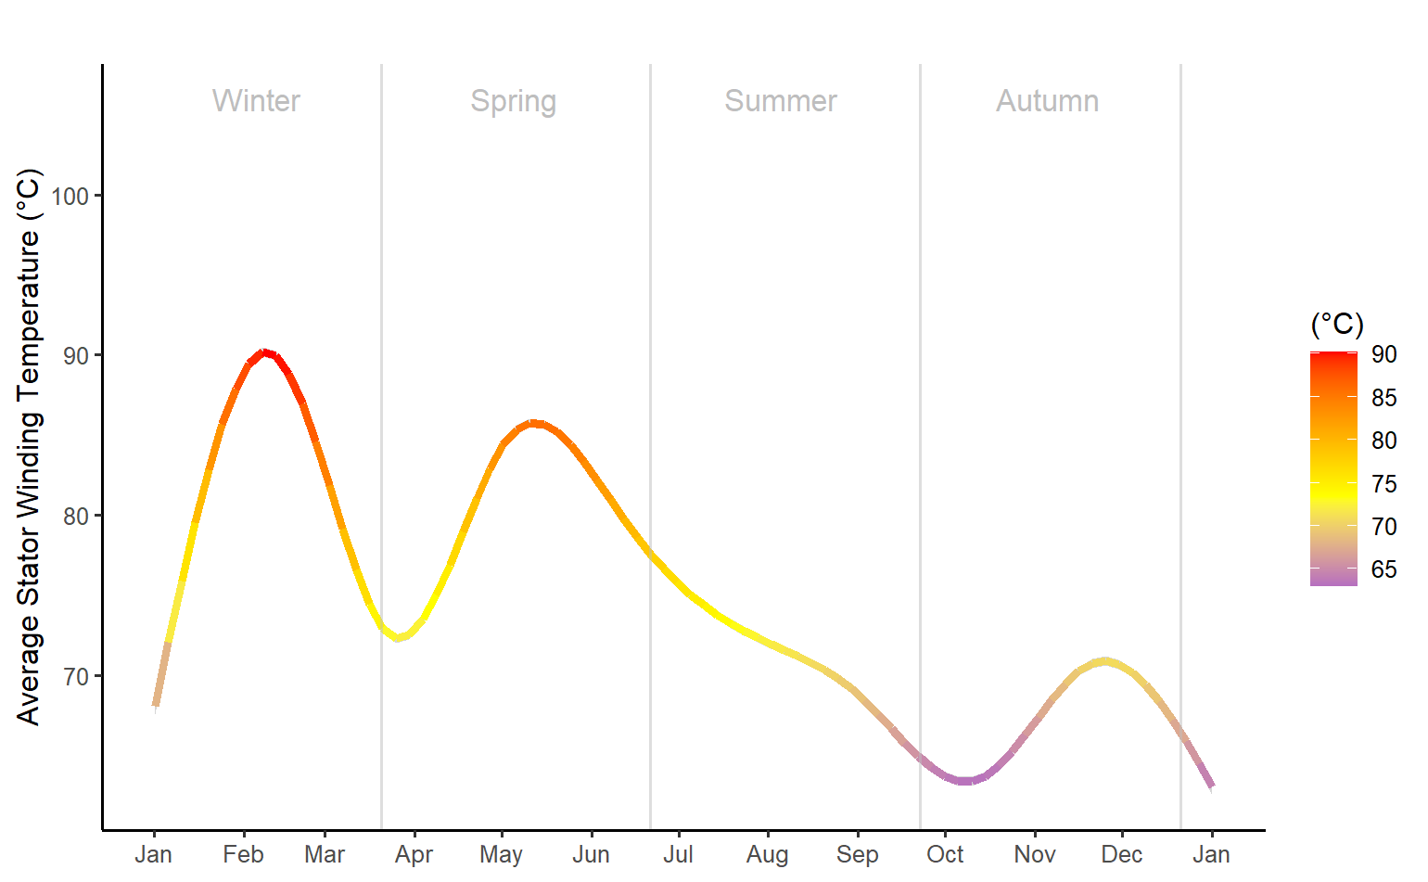
Show: Winding Temperature

Slide 11
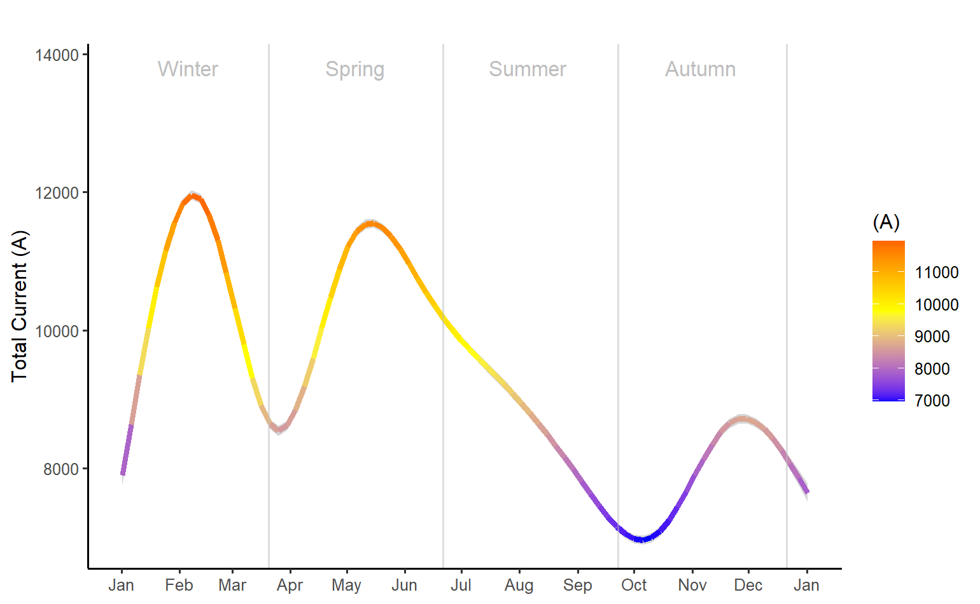
Show: Generator Electrical Current

Slide 12
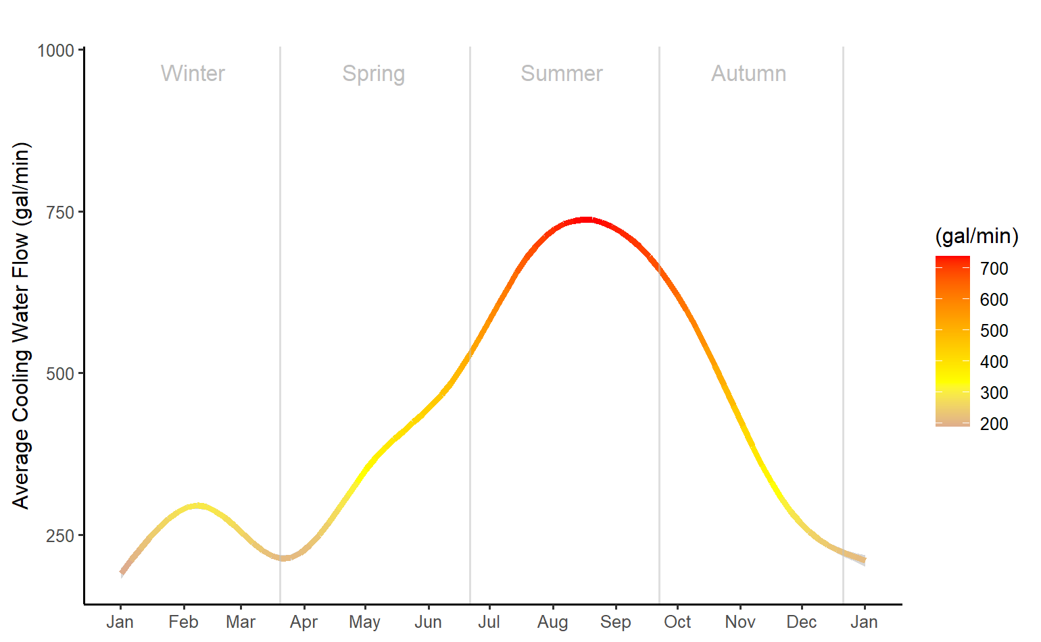
Show: Cooling Water Flow

Slide 13
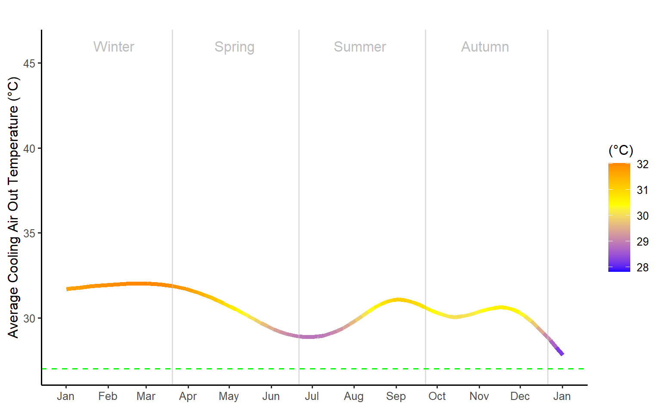
Show: Cooling Air Output Temperature

Slide 14
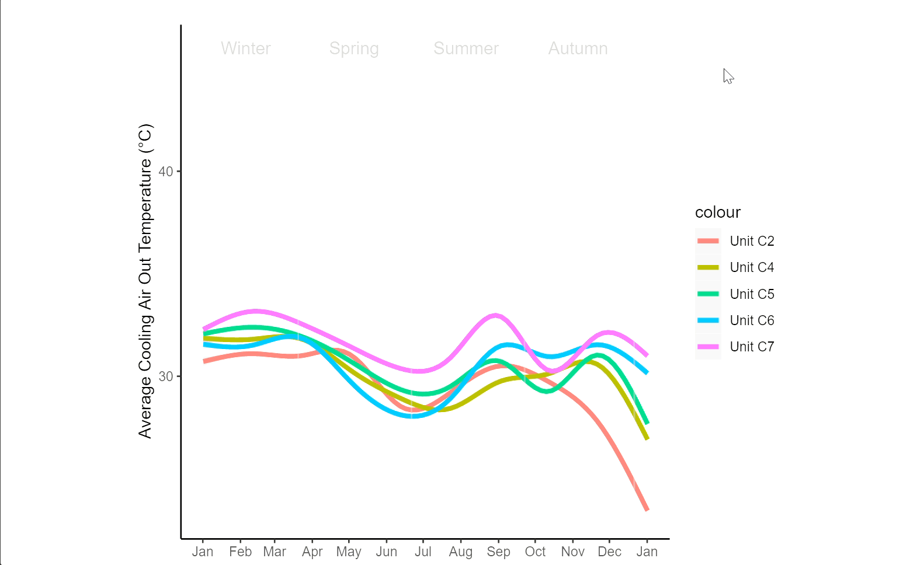
Show: Unit Difference

Slide 15
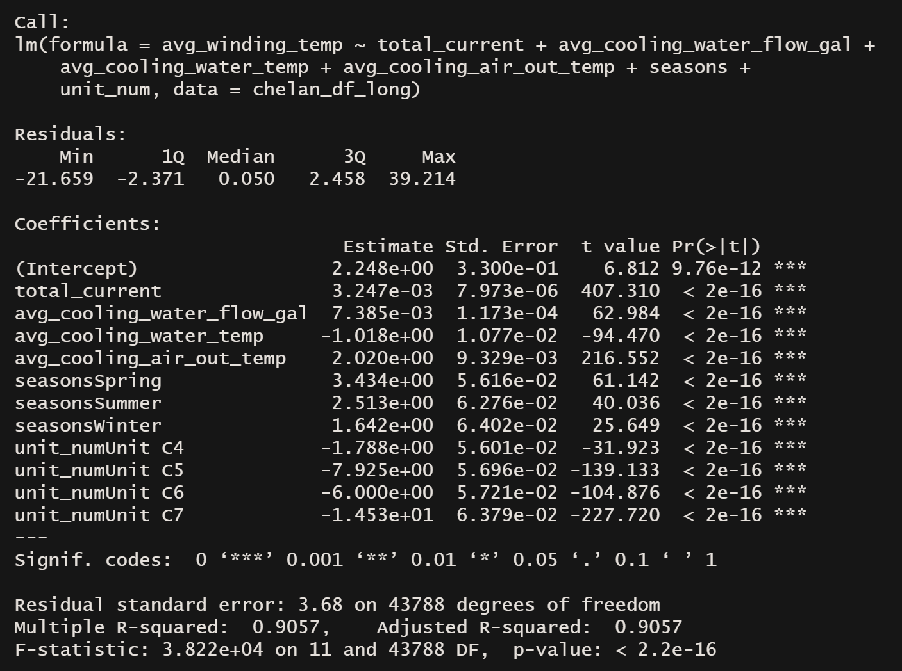
Show: linear model

Slide 16
Show: Dashboard
https://danter2000.shinyapps.io/Chelan_Shiny/

Slide 17
Report: Heating
All generators are perpetually over ABB recommended temperature target of 27 degree (c).
Despite this, overheating doesn’t appear associated with equipment failure (see slide 6).
Suggestions
Adjust PLC for PID loop correction (pg 21, GenCoolingWaterSystems_RR)
Troubleshoot with manufacture.
Work with Hydro Generation Engineers to best optimize equipment needs.

Slide 18
Report: Unit 6
Does NOT run abnormally hot
Associated with Cooling Water Temp and Flow.
Investigate if the computer system for this unit.
Possible equipment rebuild.
September and October event.

Slide 19
Report: Further Analysis
Manual vs Automatic
“Does operator control play a role in unit failure?”
“Can we predict future failures based on how long a machine is in automatic?”
(pg 26, GenCoolingWaterSystems_RR)
Maintenance
“What can maintenance logs tell us about unit failures?”
Using continually updating data for real time failure alerts
Use dashboard, R, SQL, and collaborate with team to create nudge messaging system.

